Slide 1
Full-Scale Analysis of Tech Influencer’s Instagram Reach & Engagement

Slide 2
Objective of the Project
Analyze Instagram data using SQL queries.
Calculate growth metrics, including new followers and reach.
Identify trends in post types, impressions, and engagement.
Provide actionable insights to optimize content strategy.
Generate monthly and quarterly performance reports.

Slide 3

Database Overview
dim_date Table: Contains time-related data for posts, including the date, month, week number, and whether the date falls on a weekday or weekend.
fact_account Table: Tracks Instagram profile activity, including the number of profile visits and new followers gained on a specific date.
fact_content Table: Provides detailed information about Instagram posts, including post category, post type (e.g., IG video, IG image), impressions, reach, likes, comments, shares, and saves.

Slide 4
Key Questions
What are the counts of unique post categories for each month?
What is the percentage breakdown of total reach by post type?
What are the total comments and saves for each post category by quarter?
What are the top three dates with the highest new followers each month?
How can we create a stored procedure to calculate total shares for each post type based on week number?

Slide 5
Key Questions
How many unique post types are found in the 'fact_content' table?
What are the highest and lowest recorded impressions for each post type?
Filter all posts published on weekends in March and April and export them to a CSV.
What are the monthly statistics for profile visits and new followers?
What is the total number of likes for each post category in July, ordered by total likes?

Slide 6


Insights & Findings

Slide 7


Question 1
How many unique post types are found in the 'fact_content' table?

Slide 8
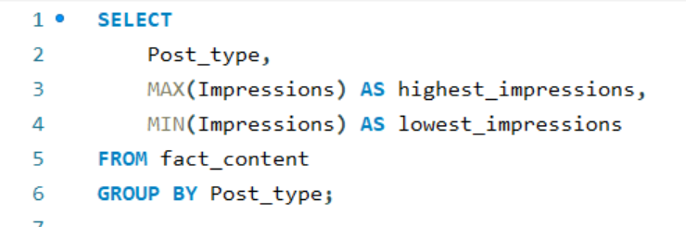
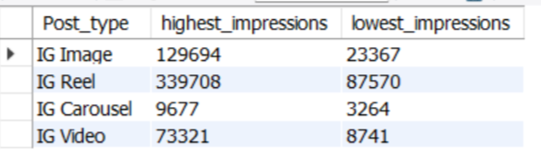
Question 2
What are the highest and lowest recorded impressions for each post type?

Slide 9
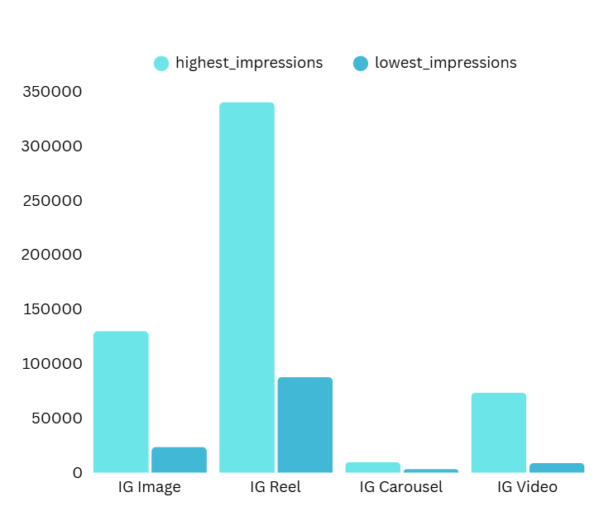
Insights:

Slide 10
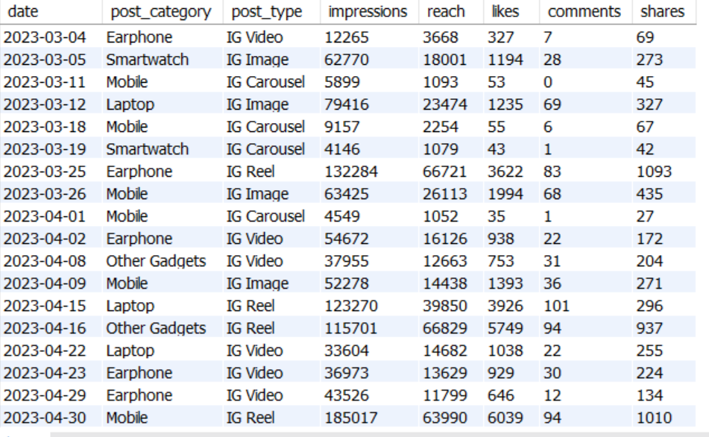
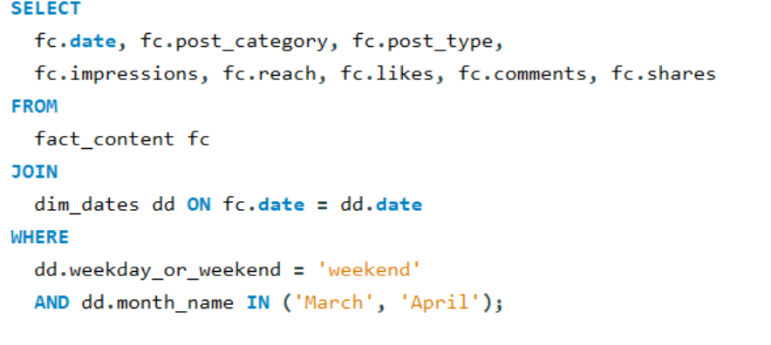
Question 3
Filter all the posts that were published on a weekend in the month of March and April

Slide 11
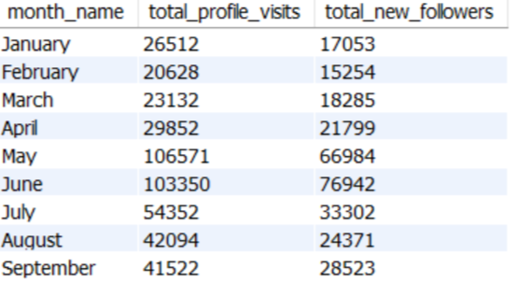
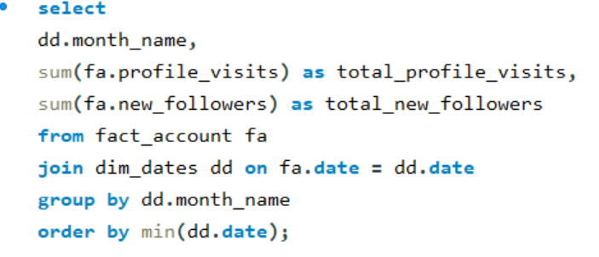
Question 4
Create a report to get the statistics for the account. The final output includes the following fields:
• month_name • total_profile_visits • total_new_followers

Slide 12
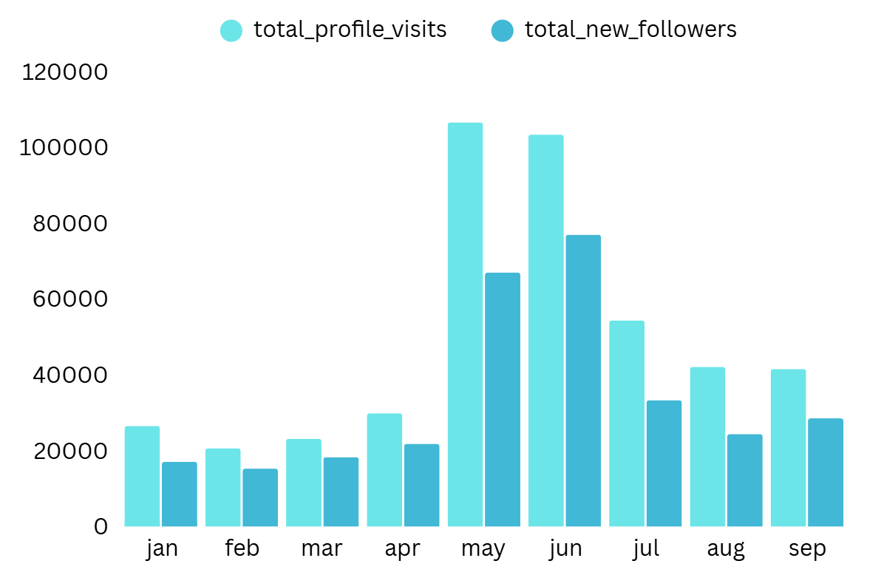
Insights

Slide 13
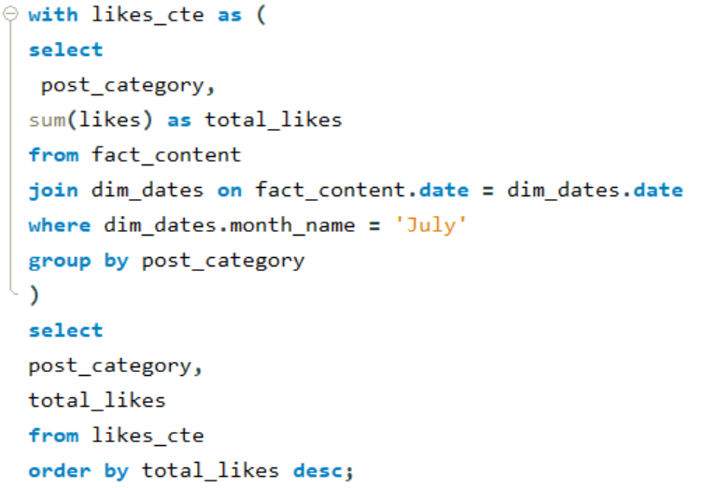
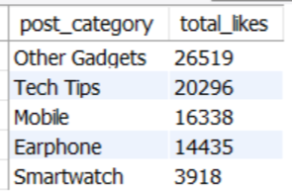
Question 5
Write a CTE that calculates the total number of 'likes’ for each 'post_category' during the month of 'July' and subsequently, arrange the 'post_category' values in descending order according to their total likes.

Slide 14
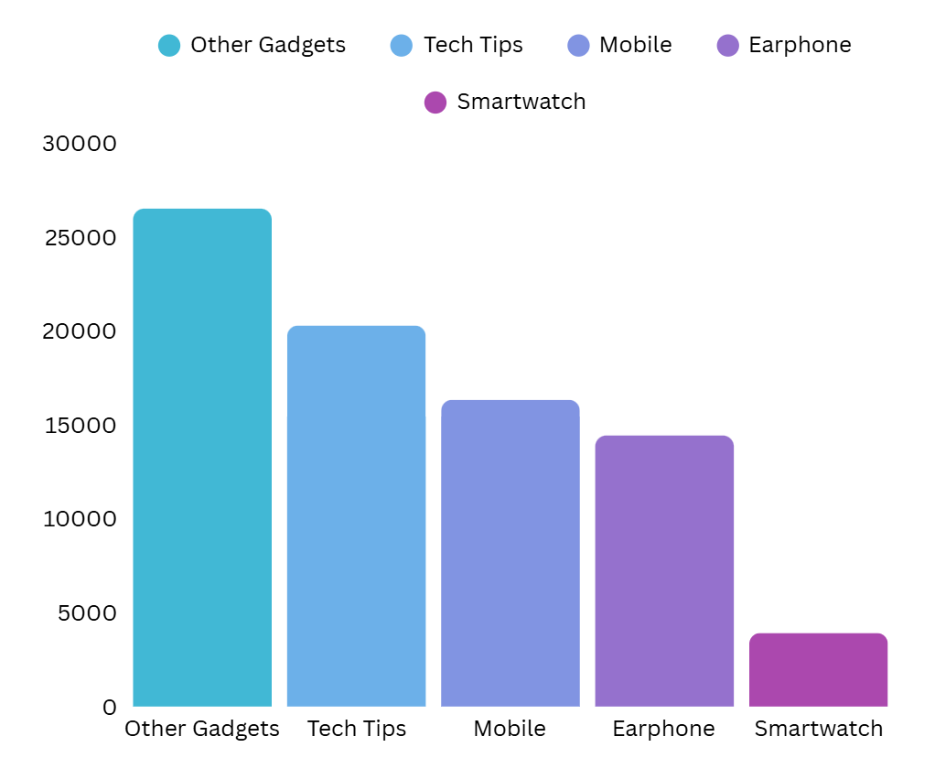
Insights

Slide 15
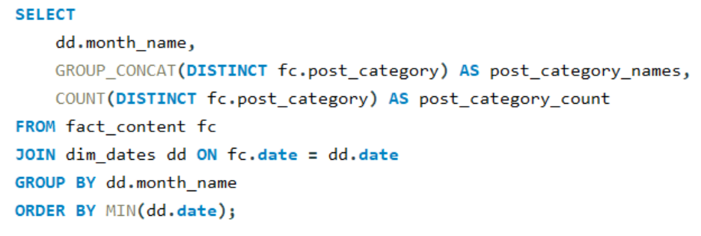
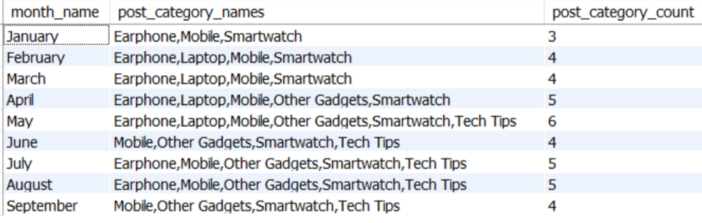
Question 6
Create a report that displays the unique post_category names alongside their respective counts for each month. The output should have three columns:
• month_name • post_category_names • post_category_count

Slide 16
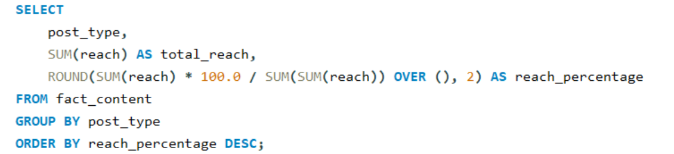
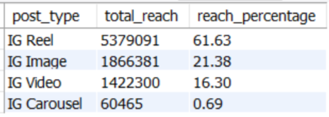
Question 7
What is the percentage breakdown of total reach by post type? The final output includes the following fields:
• post_type • total_reach • reach_percentage

Slide 17
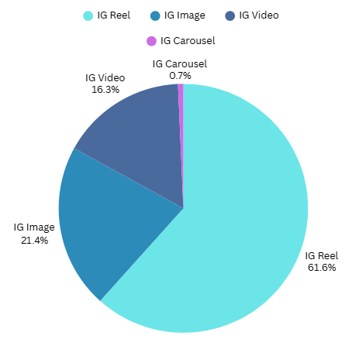
Insights

Slide 18
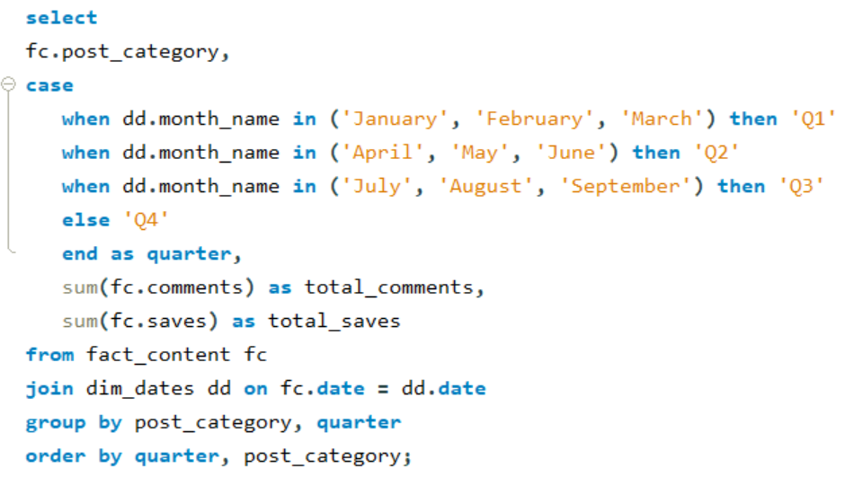
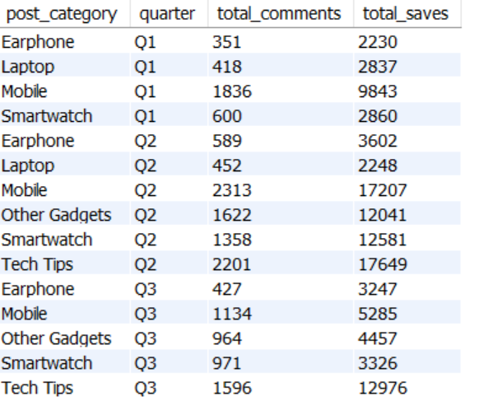
Question 8
Create a report that includes the quarter, total comments, and total saves recorded for each post category. Assign the following quarter groupings:

Slide 19
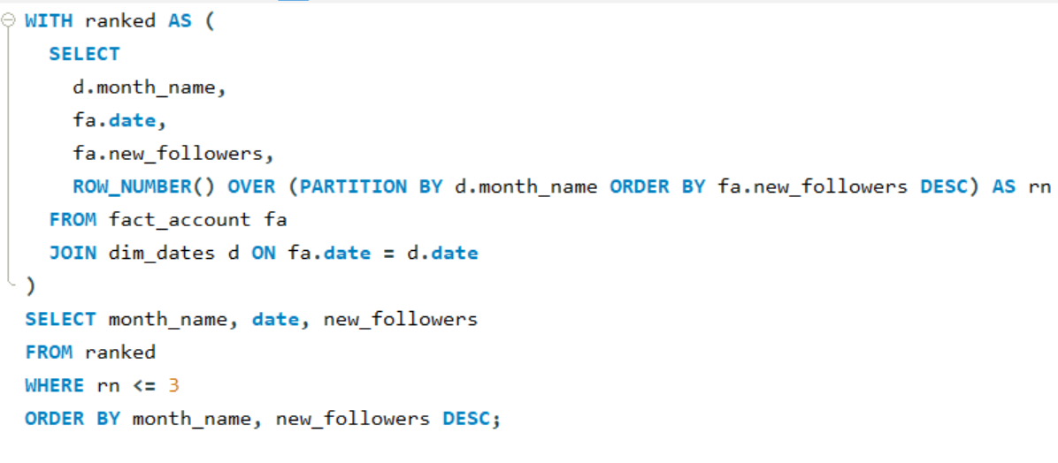
Question 9
List the top three dates in each month with the highest number of new followers. The final output should include the following columns:
• month • date • new_followers

Slide 20
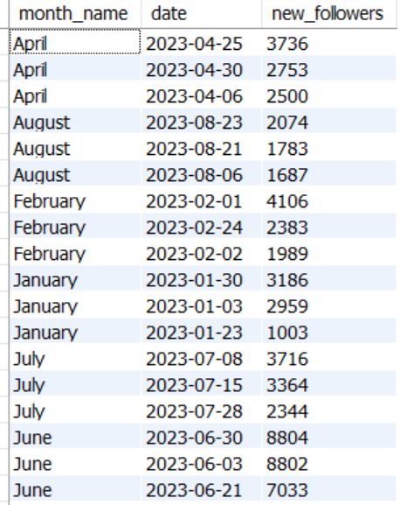
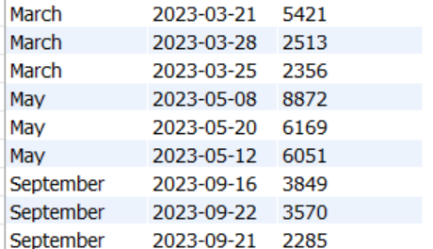
Insights

Slide 21
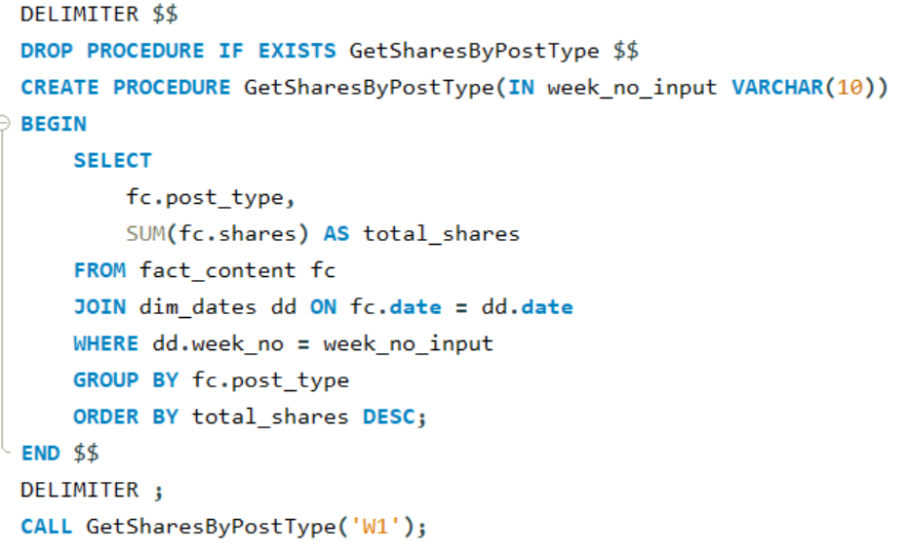
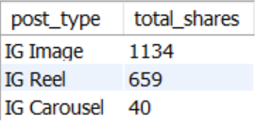
Question 10
. Create a stored procedure that takes the 'Week_no' as input and generates a report displaying the total shares for each 'Post_type'. The output of the procedure should consist of two columns:
• post_type • total_shares

Slide 22
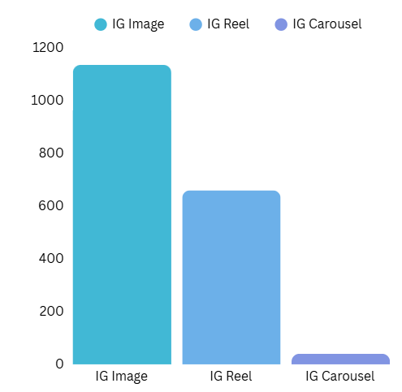
Insights

Slide 23
Thank You

